Slide 1




Presentation to the CEO & CFO of Frito Lay
Pinnacle Economics, LLC
Todd Garner DS6306
Notes:
NOTE: To replace a picture, just select and delete it. Then use the Insert Picture icon to replace it with one of your own!

Slide 2
Agenda
Why we’re here – Seeking factors regarding Attrition, Monthly Income and a host of other items
Employment Statistics BLS and Frito Lay
Attrition – contributing factors
Differing models of analysis and their limitations

Slide 3
Bureau of Labor Statistics 1992-2022 Companies with 499-999 employees

Slide 4
Frito Lay’s Attrition over the years 1992-2022
Employees | Frito Lay | Replacement | National (net)*
1990s | ? | ? | .7033%
2000s | ? | ? | .0636%
Total | (.536398%) | ? | .2967%
Only aggregate data available for Frito Lay
Replacement values unknown
Total for Frito Lay is likely lower than the National Statistics when you take into account replacements.
Frito Lay data over 40 years, BLS over 30 years
National data is [net]
Frito Lay data only Attrition
Cut in half – (0.268199%)
*net = attrition + replacements

Slide 5
K-Nearest Neighbors (KNN) – limitations
While KNN LOOCV is very robust, easy to use and stable, in most cases, it is somewhat difficult to pinpoint exact factors in the model.
Our model worked and is very accurate but ultimately MLR was chosen to drill down into specifics
High accuracy was achieved on the train/test 75%/25%
High accuracy, sensitivity and specificity was achieved on the true test (no attrition)

Slide 6
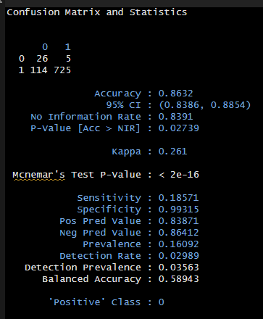
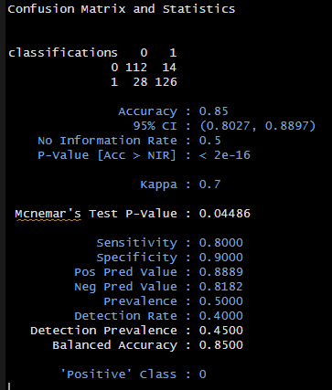
KNN.CV LOOCV Analysis on Attrition – Train/Test final set is numeric, factored, scaled & balanced

Slide 7
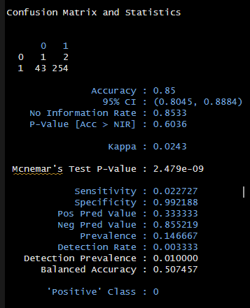
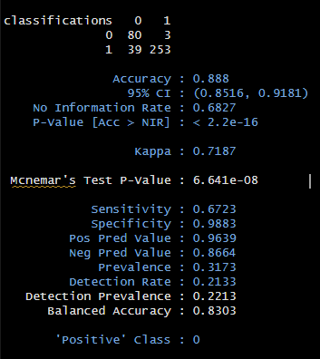
KNN.CV LOOCV Analysis on Attrition – True Test final set is numeric, factored, scaled & rebalanced (rebalance is not perfect, but you can’t argue with results)

Slide 8
Multiple Linear Regression - MLR
Multiple Linear Regression (MLR) allows weights (coefficients) to be assigned to individual variables
Data was prepared for analysis
Some variables were removed as they added no value:
Example: Total Hours Worked – 80 for each employee
Employee Count – 1 in each case
After preparation – the model was split into test and training sets. Once that was tuned properly, the “real” test model (without Attrition) was run through the model.

Slide 9

Attrition – Contributing Factors
Estimate Std. Error t-value p-v cont.*
Estimate Std. Error t-value p-v cont.*
JobInvolvement 8.384e-02 1.590e-02 5.273 1.71e-07 ***
JobSatisfaction 4.196e-02 1.003e-02 4.184 3.17e-05 ***
NumCompWorked -2.145e-02 5.081e-03 -4.222 2.69e-05 ***
OverTime -2.105e-01 2.453e-02 -8.578 < 2e-16 ***
StockOptionLevel 4.783e-02 1.329e-02 3.599 0.000339 ***
DistanceFromHome -4.152e-03 1.385e-03 -2.998 0.002796 **
EnviroSatisfaction 2.798e-02 1.017e-02 2.750 0.006090 **
WorkLifeBalance 4.159e-02 1.561e-02 2.664 0.007870 **
YearsSinceLastPromo -1.481e-02 4.633e-03 -3.197 0.001440 **
BusTravel_Freq -1.045e-01 4.293e-02 -2.434 0.015136 *
JobRoleSales Rep -2.343e-01 1.188e-01 -1.973 0.048787 *
RelationsSatis 2.363e-02 1.010e-02 2.338 0.019606 *
TotalWorkYears 6.777e-03 3.370e-03 2.011 0.044672 *
TrainTimesLastYear 1.848e-02 8.826e-03 2.094 0.036591 *
RMSE – Training Set: .09565996
RMSE – Test Set .1054616
*contribution - asterisks show contribution *** high, **med, * low

Slide 10

These appear to be the most important factors contributing to Attrition
Job Involvement
Job Satisfaction
Number of Companies Worked
OverTime (negative factor)
Stock Option Level

Slide 11
Multiple Linear Regression - the 7 key requirements:
The relationship between the independent and dependent variables is linear.
The distribution of the response for fixed values of the explanatory variables is normal.
The distribution of the residuals is normal.
The normal distributions of the response should have constant variance (standard deviation) for fixed values of the explanatory variables.
The normal distributions of the residuals should have constant variance (standard deviation) for fixed values of the explanatory variables.
Explanatory variables are independent of one another. (No multicollinearity).
Observations are independent of one another.
Next Page – Combinations of various analyses addressing these 7 requirements

Slide 12
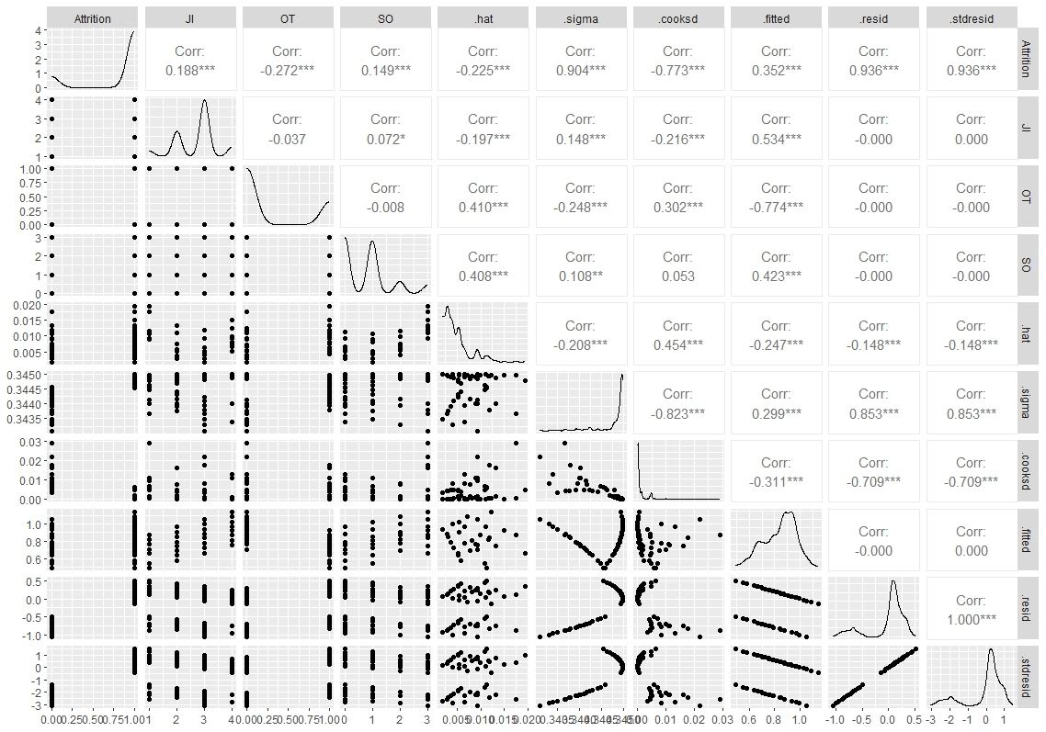
Multiple Linear Regression - the 7 key requirements:

Slide 13
Attrition Equation from linear regression
Attrition = .4687 + 0.09136(JobInvolvement) + 0.04156(JobSatisfaction)
- 0.21743(OverTime)
Attrition > 0.5 = Still Working
Attrition < 0.5 = Not working at Frito Lay anymore (fired, resigned, retired, died, etc.)
JobInvolvement = 1, 2, 3, or 4
JobSatisfaction = 1, 2, 3, or 4
OverTime = 0 or 1
Combinations that lead to Attrition – (Score of < 0.5 in the Attrition Equation)
JobInvolvement = 1
JobSatisfaction = 1, 2, and 3
OverTime = 1

Slide 14
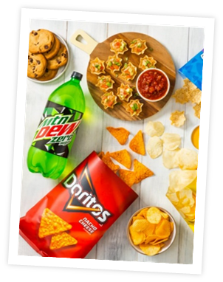
MLR takeaways
Although these few variables were likely the primarily responsible for Attritions, given the results from MLR, one factor was critical in the Attrition or Not Attrition category:
OverTime
Given the equation below, it came down to that factor being responsible for Attrition going below 0.5 or 50%.
Attrition = .4687 + 0.09136(JobInvolvement) + 0.04156(JobSatisfaction)
- 0.21743(OverTime)

Slide 15
Monthly Income
Utilizing MLR and RMSE (root mean squared error), we tackled the issue of predicting Monthly Income.
This was much the same process as Attrition but the levels of JobRoles became quite an issue.
I initially used factorization on JobRoles to let RStudio translate to dummy variables and handle the different levels within the variable.
The problem arose when a couple of the levels (specific Job Roles) showed much more significance than others.
Running those specific Job Roles back through the linear regression model became daunting.
I was able to reduce to a few specific variables, but was not able to reduce the RMSE below $3,000. In fact, $6,000 was the limit.
The pertinent variables are as follows:
1. JobLevel ***
2. JobRoleResDirector***
3. JobRoleManager ***
4. JobRoleDirector ***
5. TotalWorkingYears ***

Slide 16
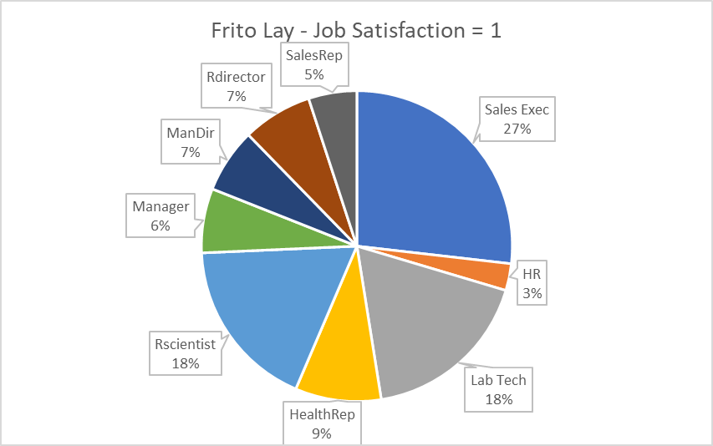
Low Job Satisfaction
Sales Jobs – 32%
Human Resources – 3%
Technical Jobs – low-ish low job satisfaction, across many categories

Slide 17
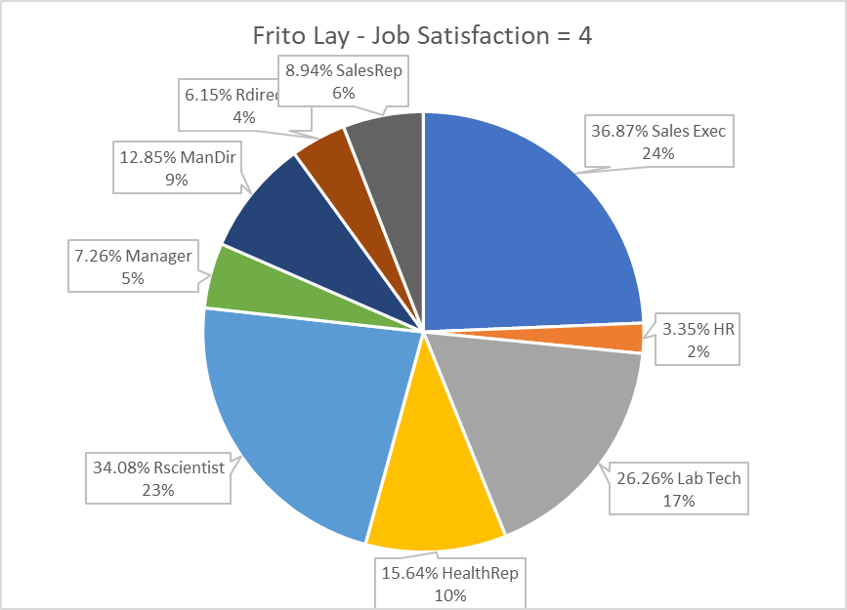
High Job Satisfaction
Sales Jobs – 30%
Human Resources – 12%
Technical Jobs – highest satisfaction, across many categories -58%

Slide 18
Thank you Frito Lay
Pinnacle Economics, LLC
Todd Garner DS6306
toddg@smu.edu
Notes:
NOTE: To replace a picture, just select and delete it. Then use the Insert Picture icon to replace it with one of your own!

